Slide 1
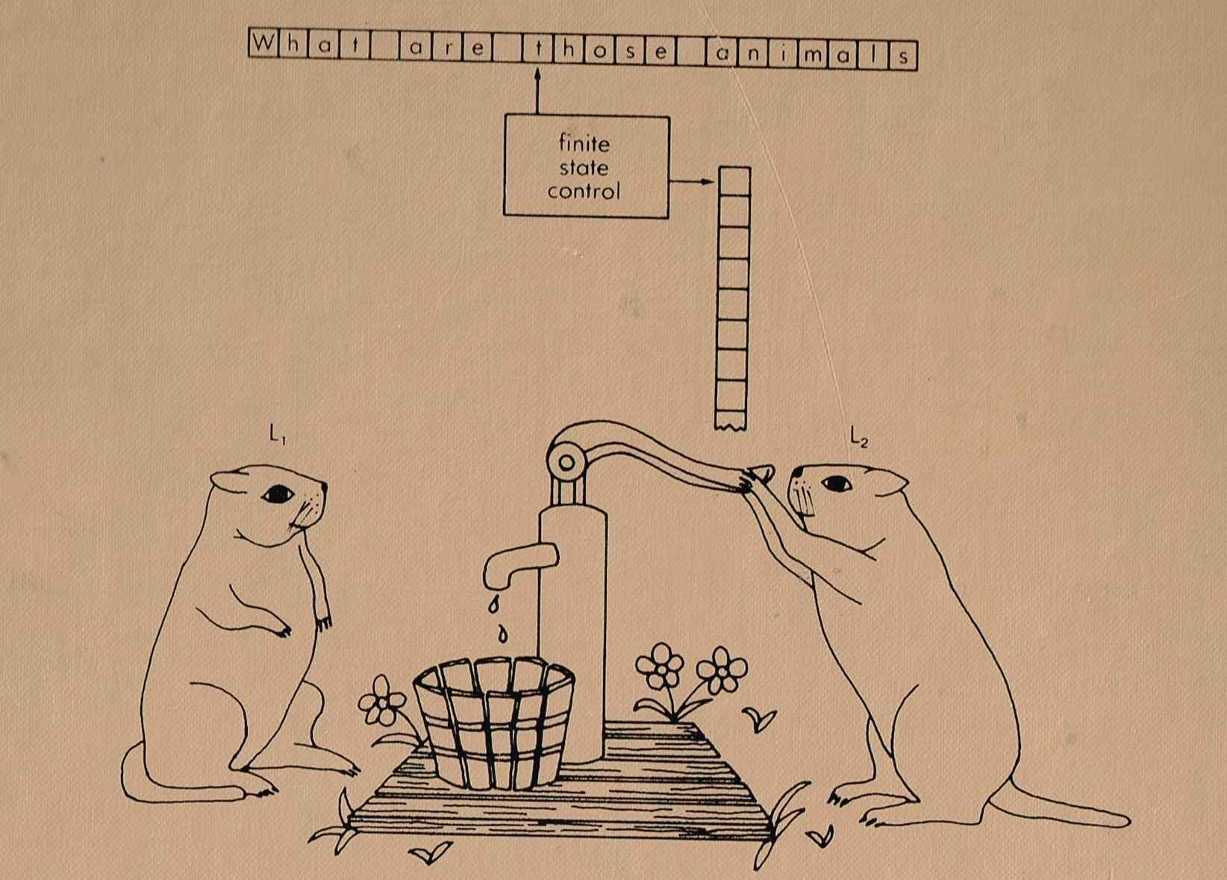
CS 611 Theory of Computation Grammars
http://www.labouseur.com/courses/compilers/compilers/alan/
Instructor: Jiaofei (Fay) Zhong, Email: jiaofei.zhong@csueastbay.edu

Slide 2
How to Specify the Language
How to specify the language
RE is not powerful enough
Statements are nested, RE cannot specify that
Matching ‘(’ and ‘)’ in expressions, RE cannot specify that
Need more powerful constructs: Grammar
Specifically, context free grammar
There can be other grammars
For example, regular grammar

Slide 3
Grammar
Definition
G = ( T, N, S, P )
T: Terminals
N: Non-terminals
S: Start symbol
P: Production rules
T: the set of terminals
Terminals are essentially the tokens
Similar to the set of symbols in RE/FA
Generally represented by lower case alphabets in grammars
E.g., if, while, a, b
Also, +, >
Also, id (represent the identifiers, not the alphabets themselves)

Slide 4
Grammar
Definition
G = ( T, N, S, P )
N: the set of non-terminals
Used in production rules to generate substrings
Functionality-wise, similar to the states in FA
Generally represented by upper case alphabets
But for language specification, specialized form is used, such as BNF
N ∪ T
Sometimes, it is necessary to represent a substring in N ∪ T
Generally use lower case Greek alphabets to represent such substrings
E.g., α, β, γ, δ

Slide 5
Grammar
Definition
G = ( T, N, S, P )
S: starting symbol
A nonterminal symbol from which the derivation starts
Functionality-wise, similar to the starting state in FA
P: the set of production rules
Define how non-terminals can be expanded
Functionality-wise, has some similarity to the transitions in FA
There are a finite set of production rules in a grammar
Production rules in context free grammar:
A single non-terminal → A string of terminals and non-terminals
Other parts of the grammar
Separator: , (to separate multiple productions)
Alternation: | (to put several productions together)

Slide 6
Derivation
Based on the grammar, derivations can be made
The purpose of a grammar is to derive strings in the language defined by the grammar
α ⇒ β, β can be derived from α in one step
⇒⁺ derived in one or more steps
⇒* derived in any number of steps
⇒_{lm} leftmost derivation
Always substitute the leftmost non-terminal
⇒_{rm} rightmost derivation
Always substitute the rightmost non-terminal

Slide 7
Context Free Grammar
CFG
Is a type of grammar most commonly used
Left side is always a single nonterminal
Example
T = {a, b, c}
N = {S, A, B} and S is the starting symbol
P includes three rules
S → AB
B → b
A → aA | c

Slide 8
Derivation and Parse Tree
Example
S → AB
B → b
A → aA | c
Derivation
Start from S, follow the rules to expand and lead to a string
E.g., S ⇒ AB ⇒ aAB ⇒ aAb ⇒ aaAb ⇒ aacb
Parse tree
A tree representing a derivation
All internal nodes are non-terminals
All leaf nodes are terminals
Build the tree following the derivation
S
A
B
a
A
b
a
A
c

Slide 9
Derivation and Parse Tree
Example
S → AB
B → b
A → aA | c
Derivation:
Arbitrary order (previous one)
S ⇒ AB ⇒ aAB ⇒ aAb ⇒ aaAb ⇒ aacb
Leftmost derivation:
S ⇒ AB ⇒ aAB ⇒ aaAB ⇒ aacB ⇒ aacb
Rightmost derivation:
S ⇒ AB ⇒ Ab ⇒ aAb ⇒ aaAb ⇒ aacb
A parse tree always has a unique leftmost derivation and a unique rightmost derivation
S
A
B
a
A
b
a
A
c

Slide 10
CFG, Derivation, Parse Tree
Another example
E → E * E | E + E | ( E ) | id
Build a parse tree for: id * id + id * id
Can have different ways
E
E
E
E
+
E
E
*
E
E
*
E
E
*
E
E
*
E
E
+
E
E
*
E
id
id
E
*
E
E
+
E
id
id
id
id
id
id
Ambiguity.
If, for some input string that can be derived from the grammar,
there exists more than one parse tree to parse it,
then the grammar is ambiguous
id
id
id
id

Slide 11
Ambiguity and Derivations
Leftmost: E ⇒ E * E ⇒ id * E ⇒ id * E + E ⇒ id * id + E ⇒ id * id + E * E ⇒ id * id + id * E ⇒ id * id + id * id
Rightmost: E ⇒ E * E ⇒ E * E + E ⇒ E * E + E * E ⇒ E * E + E * id ⇒ E * E + id * id ⇒ E * id + id * id ⇒ id * id + id * id
Leftmost: E ⇒ E + E ⇒ E * E + E ⇒ id * E + E ⇒ id * id + E ⇒ id * id + E * E ⇒ id * id + id * E ⇒ id * id + id * id
Rightmost: E ⇒ E + E ⇒ E + E * E ⇒ E + E * id ⇒ E + id * id ⇒ E * E + id * id ⇒ E * id + id * id ⇒ id * id + id * id
Example grammar
E → E * E | E + E | ( E ) | id
Derive: id * id + id * id
E
E
E
*
E
E
+
E
E
+
E
E
*
E
E
*
E
id
Multiple derivations do not imply ambiguity,
only multiple parse trees do.
If the grammar is ambiguous then there exists multiple parse trees for the grammar, and for each parse tree, there is a unique leftmost derivation and a unique rightmost derivation.
E
*
E
id
id
id
id
id
id
id

Slide 12
Ambiguity
E
Ambiguity implies multiple parse trees
Can make parsing more difficult
Can impact the semantics of the language
Different parse trees can have different semantic meanings, yield different execution results
Sometimes, rewrite the grammar can eliminate ambiguity
But it may add additional semantics in the language
Eliminate ambiguity
E → E + T | E * T | (E) | T
T → id
Derive: id * id + id * id using leftmost derivation
E ⇒ E * T ⇒ E + T * T ⇒ E * T + T * T ⇒ E * T + T * T ⇒ T * T + T * T ⇒ … ⇒ id * id + id * id
E
*
T
E
+
T
id
E
*
T
id
T
id
id
Notes:
Parse tree:
Is this what we want?

Slide 13
Ambiguity
Rewrite grammar to eliminate ambiguity
Many ways to rewrite the grammar
The new grammar should accept the same language
For each input string, there may be multiple parse trees
Each has a different semantic meaning
Which one do we want?
Rewrite grammar should be based on the desired semantics
There is no general algorithm to rewrite ambiguous grammars

Slide 14
Rewrite Ambiguous Grammar
Try to use a single recursive nonterminal in each rule
When the left symbol appears more than once on the right side, use additional symbols to substitute them and allow only one
Force to only allow one expansion
Example grammar
E → E + E | E – E | E * E | E / E | (E) | id
It is ambiguous
Change to
E → T + E | T – E | T * E | T / E | (E) | T
T → id
Parse: id * id – id
E ⇒ T * E ⇒ T * T – E ⇒ T * T – T ⇒ … ⇒ id * id – id
E
T
*
E
id
T
–
E
id
T
id

Slide 15
Rewrite Ambiguous Grammar
Build desired precedence in the grammar
Example
E → E + E | E * E | (E) | id
Ambiguous
Desired precedence: * executes before +
Change to
E → E + T | T
T → T * F | F
F → (E) | id
Parse id + id * id
E
E
+
T
T
T
*
F
F
F
id
id
id

Slide 16
Ambiguity – Another Example
if statement
stmt → if-stmt | while-stmt | …
if-stmt → if expr then stmt else stmt | if expr then stmt
Parse: if (a) then if (b) then x = c else x = d
if-stmt
if-stmt
if
expr
then
stmt
else
stmt
if
expr
then
stmt
(a)
if-stmt
x=d
(a)
if-stmt
if
expr
then
stmt
if
expr
then
stmt
else
stmt
(b)
x=c
(b)
x=c
x=d

Slide 17
Ambiguity – Another Example
if statement
stmt → if-stmt | while-stmt | …
if-stmt → if expr then stmt else stmt | if expr then stmt
Recursion in the rule
Not immediate recursion
Expands to another nonterminal then to itself
Indirect recursion in two places
Desired semantics
Match the else with the closest if

Slide 18
Ambiguity – Another Example
How to rewrite the if-stmt grammar to eliminate ambiguity?
By defining different if statements: unmatched and matched
Matched: with both then and else parts
By disallowing matched stmt to go back to unmatched stmt
if-stmt → unmatched-stmt | matched-stmt
matched-stmt→ if expr then matched-stmt else matched-stmt
Once getting into matched-stmt, never go back to unmatched-stmt
unmatched-stmt→ if expr then unmatched-stmt
unmatched-stmt→ if expr then matched-stmt else unmatched-stmt
In unmatched stmt, need to consider both matched and unmatched
In matched case, anything in the then part has to be matched
It is possible to have unmatched in the else part
Question: Can unmatched-stmt or matched-stmt derive stmt?
Notes:
In the last question, we can see that this solution is problematic. In the given grammar, stmt can generate another type of statement. But in the revised grammar, once we get matched or unmatched stmt, it cannot continue to generate anything else. Another solution is given on the next page.

Slide 19
Ambiguity – Another Example
Another way to rewrite the if-stmt grammar to eliminate ambiguity:
1:
stmt → ... | if-stmt
2:
stmt-with-else → ... | if-stmt-with-else
3:
if-stmt → ... | if expr then stmt | if expr then stmt-with-else else stmt
4:
if-stmt-with-else → ... | if expr then stmt-with-else else stmt-with-else
Notes:
Any other statement related grammar rules may also have to be duplicated in this way if they may directly or indirectly end with a stmt or if-stmt non-terminal.

Slide 20
Ambiguity
Rewritten grammar
Less intuitive
Harder to comprehend by the language designer as well as the user of the language
Current practice
Expression
Precedence is desired, so, good to use the grammar with precedence
If
Language definition still has the ambiguous grammar
Use some ad hoc method to resolve the problem (which is also easy to deal with)

Slide 21
General Concept: Languages and Grammars
Grammars are classified into 4 classes
Chomsky–Schützenberger hierarchy
Modifications may have been made later
Type-2 grammar: Context free grammar
Productions rules A → β
A is a non-terminal
β ∈ (N ∪ T)⁺ ∪ {ε}
Context free grammar can specify any context free language and can only specify context free language
Put in another way: all languages that can be specified by context free grammars are called context free languages

Slide 22
Languages and Grammars
Type-3 grammar: Regular grammar
Productions rules can only be
A → a | A → aB | A → ε
Regular grammar and regular expression are equivalent
Regular grammar can be constructed based on DFA
If we consider constructing from NFA, then the production rules can be
A → a | A → aB | A → ε | A → B
This is to allow the moves on ε

Slide 23
Languages and Grammars
Type-3 grammar
Example: (a|b)*abb
Corresponding NFA
Corresponding regular grammar
A₀ → a A₀ | b A₀
A₀ → a A₁
A₁ → b A₂
A₂ → b A₃
A₃ → ε
a
start
S₀
a
S₁
b
S₂
b
S₃
b

Slide 24
Languages and Grammars
How to construct regular grammar from NFA
Assign a non-terminal symbol for each state in NFA
A_{i} for state i
If state i has a transition to state j on input a then
A_{i} → a A_{j}
If state i has a transition to state j on empty input then
A_{i} → A_{j}
If state i is the accepting state then
A_{i} → ε
If state i is the starting state then
A_{i} is the staring symbol

Slide 25
Languages and Grammars
What is the limitation of context free grammar?
Try to write the context free grammar for
L1 = { a^{n}b^{n} | n ≥ 0}
L2 = { a^{n}b^{n}c^{n} | n ≥ 0}
L3 = { wcw | w = (a|b)* }
L4 = { wcw^{r} | w = (a|b)* } w^{r} is reverse of w
L5 = { a^{n}b^{m}wc^{n}d^{m} | m, n ≥ 0}
Use of the above languages
L3: a variable before its use should be declared
L5: a^{n}b^{m} are the formal parameters defined in two procedures
c^{n}d^{m} are the matching numbers of actual parameters
L2: printer file: a^{n} all characters, b^{n} all backspaces, c^{n} all underlines
first prints all the chars, then back to the beginning to print underlines

Slide 26
Languages and Grammars
Context free grammar still has limited power
What is beyond?
Type-0 and type-1 grammars
Generally, in compiler
Features corresponds to L3, L5 are checked with other mechanisms
More efficient

Slide 27
Languages and Grammars
Type-1 grammar: Context sensitive grammar
Production rules
Include all possible rules in type-2 grammar
Also allow rules of the form: αAβ → αγβ
Replace A by γ only if found in the context of α and β
Left side does not have to be a single non-terminal
α, β ∈ (N ∪ T)*
γ ∈ (N ∪ T)* − ε (no erase rule)
Corresponds to recursive language

Slide 28
Languages and Grammars
Type-0 grammar
Production rules
Include all possible forms for the rules
Allow rules of the form: α → β
α ∈ (N ∪ T)* N (N ∪ T)*
At least one non-terminal
β ∈ (N ∪ T)*
Corresponds to recursive enumerable language
Include all languages that are recognizable by Turing machine

Slide 29
Languages and Grammars
What can context sensitive grammars do?
Write a grammar for a^{n}b^{n}c^{n}
S → aSBC
S → aBC
CB → BC
aB → ab
bB → bb
bC → bc
cC → cc
Small note about CB → BC
Can be considered as context sensitive in a modified definition
α → β, len(α) ≤ len(β) has been proven to produce CSL
Derivation: S ⇒ aSBC ⇒ aaBCBC ⇒ aaBBCC ⇒ aabBCC ⇒ aabbCC ⇒ aabbcC ⇒ aabbcc
Generate as many a’s as necessary
Generate the last a; Now the string has as many a’s and B’s and C’s
Switch CB so that B’s and C’s are in the correct order
Substitute the first B by b
Substitute the rest B’s
Substitute the first C by c
Substitute the remaining C’s

Slide 30
Languages and Grammars
S → aSBC
S → aBC
CB → BC
aB → ab
bB → bb
bC → bc
cC → cc
What can context sensitive grammars do?
Write a grammar for a^{n}b^{n}c^{n}
Is it possible to accept strings other than a^{n}b^{n}c^{n}
S ⇒ aSBC ⇒ aaBCBC ⇒ aabCBC ⇒ aabcBC ⇒ fail
Why no other strings possible?
If the CB → BC switch is done fully
Can only substitute sequentially to reach a^{n}b^{n}c^{n}
B and C cannot be substituted without a terminal proceeding it
If the CB → BC switch is not done fully
No way to generate new “a”s after a “b” is substituted
Once a “c” is generated, if there is any remaining B, there is no way to substitute it

Slide 31
Languages and Grammars
Language classes
Type-0 languages
(recursive enumerable)
Type-1 languages
(context sensitive)
Type-2 languages
(context free)
Type-3 languages
(regular)

